Slide 1
Big Mountain Resort - Executive Report
Problem Identification:
Context: Big Mountain Resort is seeking to optimize its ticket pricing strategy in the competitive ski resort market.
Problem Statement: Despite offering premium facilities compared to other resorts in Montana, Big Mountain Resort's current ticket pricing does not reflect its market position, potentially leading to unrealized revenue.

Slide 2
Scenarios Considered
Closing down 10 least used runs.
Increase vertical drop with increase in snow making coverage.
Increase vertical drop with additional snow making coverage.
Increase longest run.
Key Findings:
Scenario 1: Reveals that closing up to five runs would not affect ticket prices, offering an opportunity for cost
savings without impacting sales.
Scenario 2: Enables a ticket price increase of $2, suggesting that customers may value other aspects of the resort enough to absorb this hike.
Scenario 3: Which expands Scenario 2 by adding 2 more acres of snow-making, shows no significant difference in return on investment (ROI), indicating that the extra snow-making capacity does not add perceivable value over the ticket price increase alone.
Scenario 4: The outcome shows no effect on ticket prices, further emphasizes the limited impact of certain enhancements.

Slide 3
Recommendations
The most strategic move appears to focus on Scenario 1, leveraging the potential for maintenance cost savings by closing underperforming runs. It's recommended to begin with the closure of two or three runs, monitoring revenue and resort attendance quarterly to assess the positive ROI and make informed decisions moving forward.
We can raise tickets prices by $2 per ticket without affecting attendance as the model suggest and monitor revenue and attendance on a quarterly basis.

Slide 4
How we compare to other Resorts on Features
Big Mountain Resort offers a premium experience at premium prices, making it a top-tier destination nationally but notably pricier within Montana.
Its number of vertical drop is competitive among resorts, though several others have a greater drop.
The resort has a significant snowmaking capacity with 600 square acres, highlighting its commitment to maintaining quality snow conditions.
With 14 total chairlifts, Big Mountain is among the leaders in this category, with only a few resorts having more, which are considered outliers.
Big Mountain is competitive in the number of runs it offers, with about 102 runs, placing it well above most but still behind a few.
The longest run at Big Mountain is 3.5 miles, more than half the length of the longest run in the industry, though the very longest runs are rare.

Slide 5
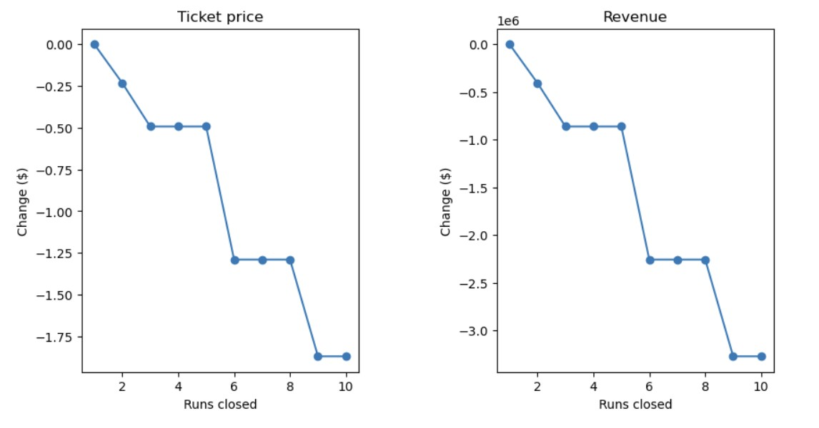
Model Results and Analysis
Visual analysis indicates that Big Mountain can close up to 5 of its least used ski runs without affecting ticket prices. Closing 1 run makes no difference, but closing 2 to 5 runs gradually reduces ticket price support, with no further loss beyond 3 runs. However, closing more than 5 runs leads to a significant drop in ticket price support and revenue, suggesting that strategic closures up to 5 runs could optimize efficiency without impacting financial performance.

Slide 6
Model Results and Analysis
In the enhancement scenarios considered for Big Mountain Resort, the strategic additions include:
Scenario 2: Adding one run, increasing the vertical drop by 150 feet, and installing an additional chair lift, which supports a ticket price increase of $1.99. This adjustment is projected to yield an additional seasonal revenue of approximately $3,474,638.
Scenario 3: Building upon Scenario 2 by adding 2 acres of snowmaking, which surprisingly does not alter the ticket price increase or revenue projection from Scenario 2, suggesting the marginal increase in snowmaking area does not significantly influence pricing or revenue.
Scenario 4: Extending the longest run by 0.2 miles and enhancing it with an additional 4 acres of snowmaking capability. This change does not affect the ticket price, indicating that while the longest run is a feature within the linear model, its influence is minimal in the random forest model used for these predictions, which is selected for its superior performance.
These scenarios indicate that significant enhancements, like adding runs, increasing vertical drops, and expanding chair lifts, can substantively support ticket price increases and boost revenue. However, marginal increases in snowmaking and extending the longest run, despite their potential appeal, do not seem to impact the financial metrics significantly, underlining the importance of focusing on changes that align closely with customer value perceptions and pricing strategies.

Slide 7
Conclusion
The most significant benefit arises from implementing Scenario 1, which could yield savings in maintenance costs by closing underperforming runs. A phased approach could be adopted, initially closing two to three runs, followed by a quarterly review of revenue and resort attendance to evaluate the return on investment.

